Slide 1
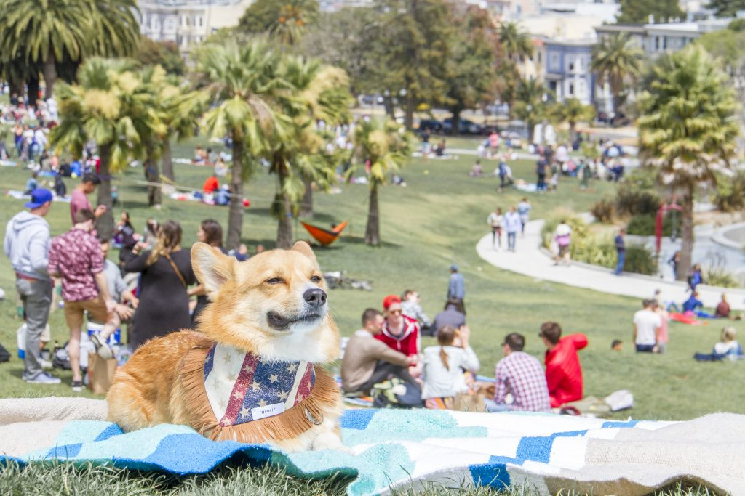
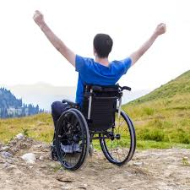
REstaurant Access in SF
An analysis on eating with your pet pals and wheelchair accessibility
Carolyn Tsai Michael Hissey Derrick Humphrey

Slide 2
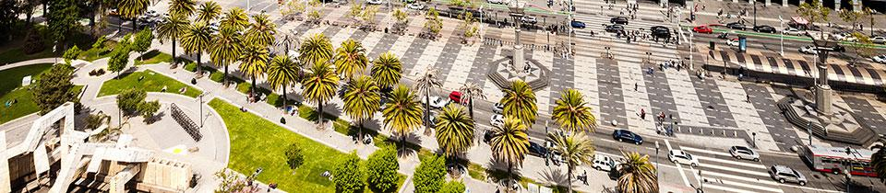
Eating in SF
How accessible is SF?
Neighborhoods?
Our approach

Slide 3
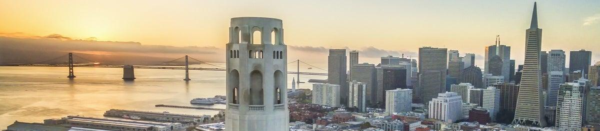
Methodologies
Source We Used
Data Gathering
Data Transformation

Slide 4
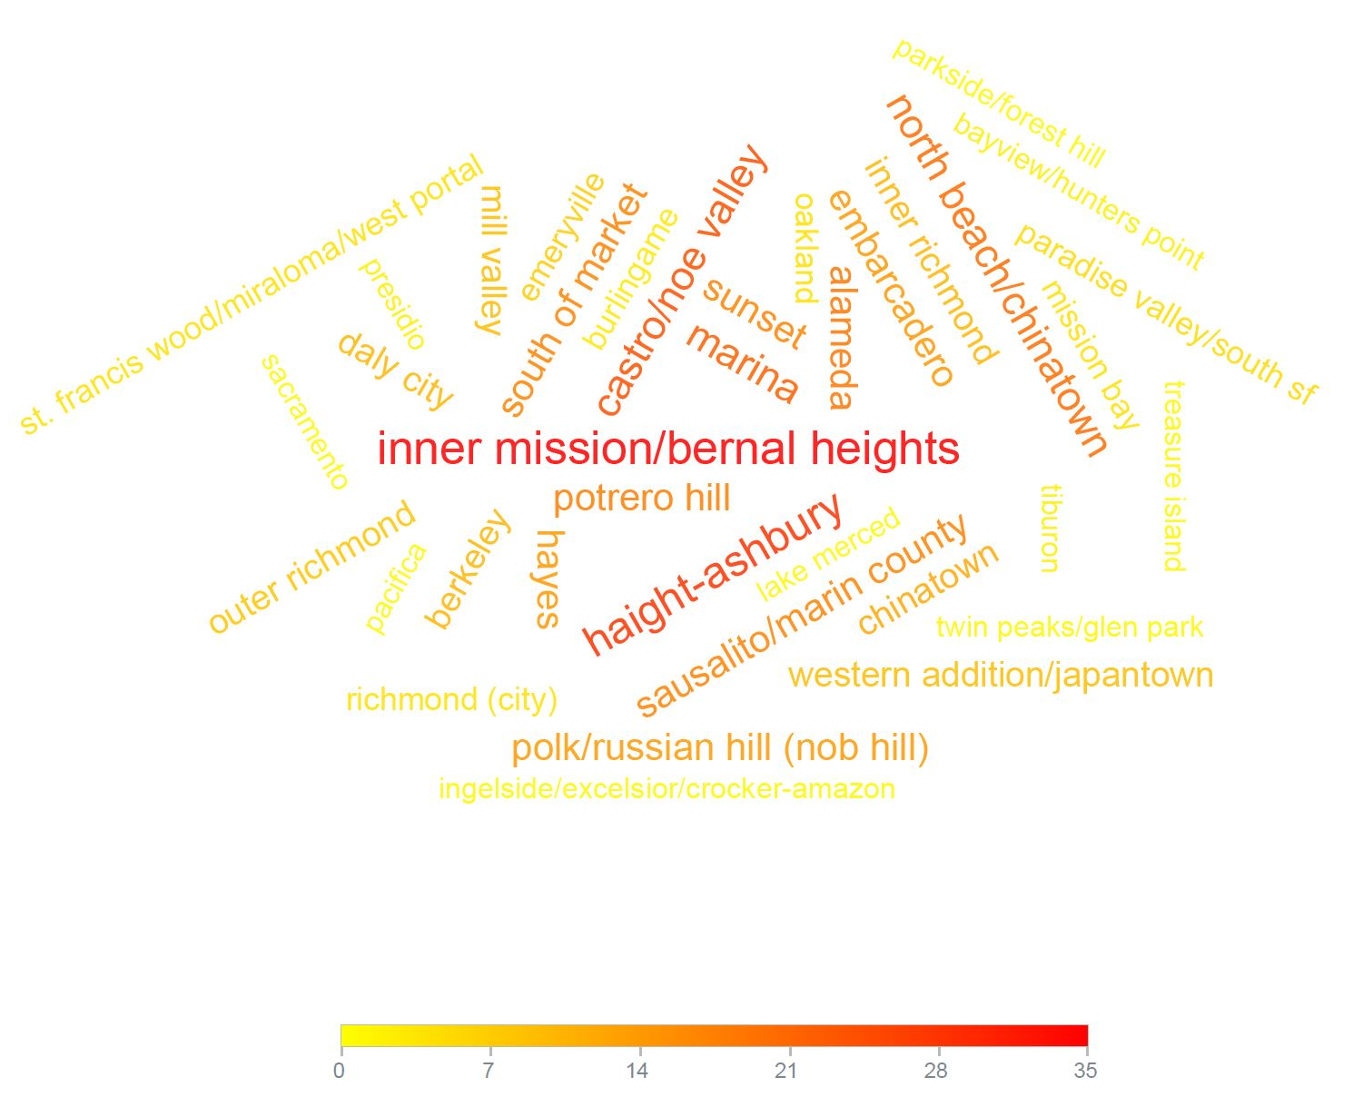
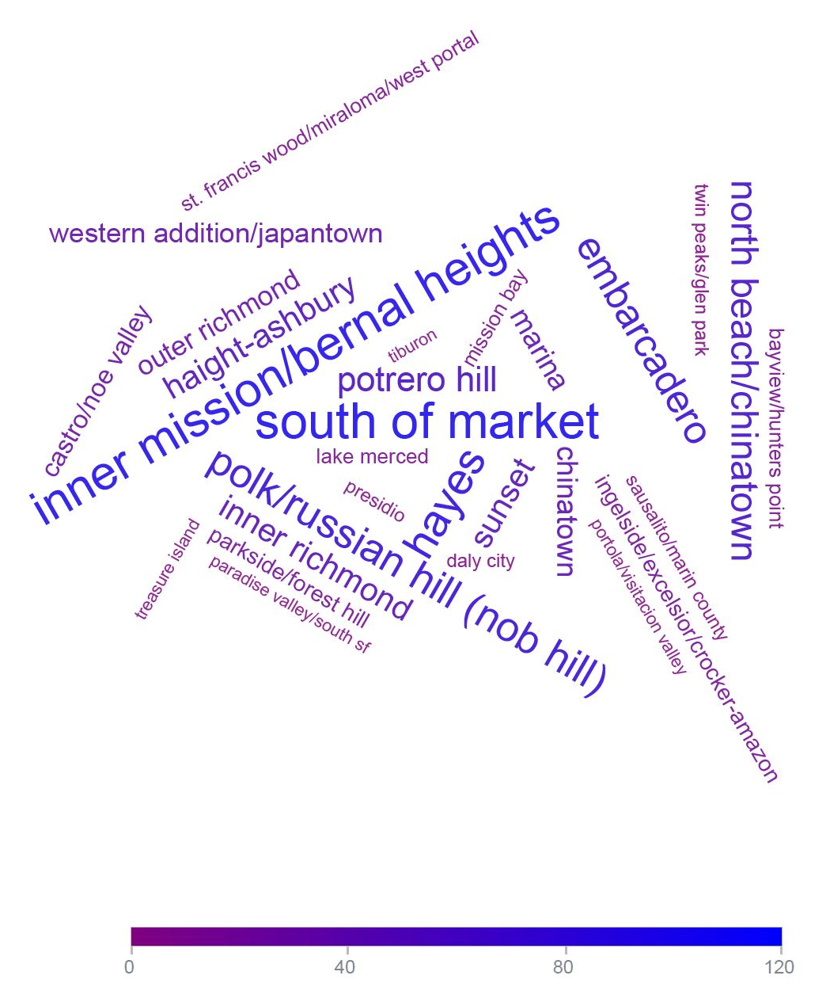
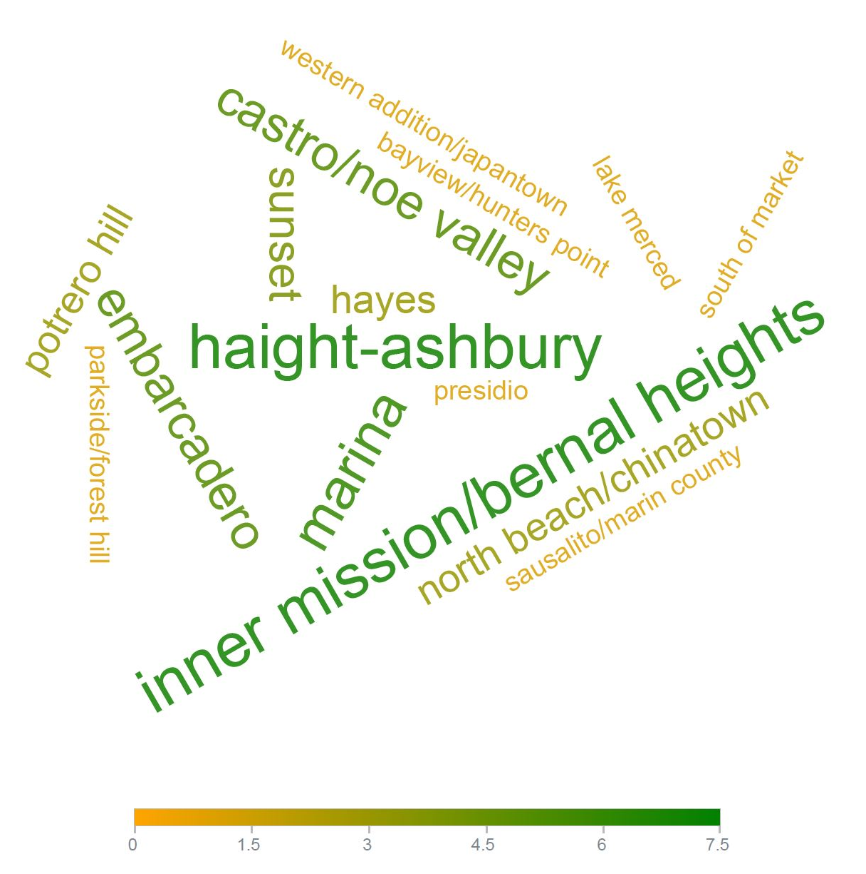
Data visualization - Word clouds
Pets
Wheelchairs
Pets & Wheelchairs

Slide 5
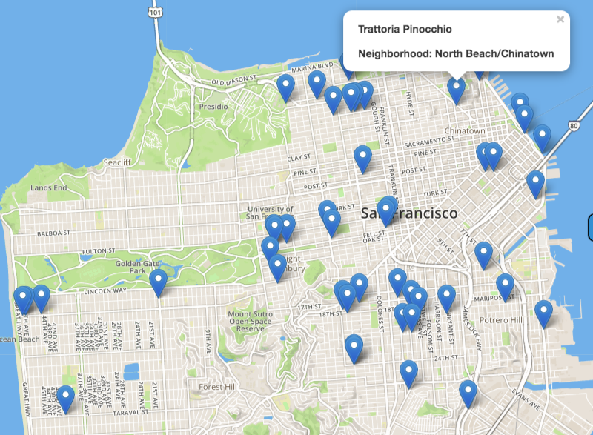
Data visualization
Leaflet
What About This Map?
Citi Codes
//<UGH!>Flask</UGH!>

Slide 6
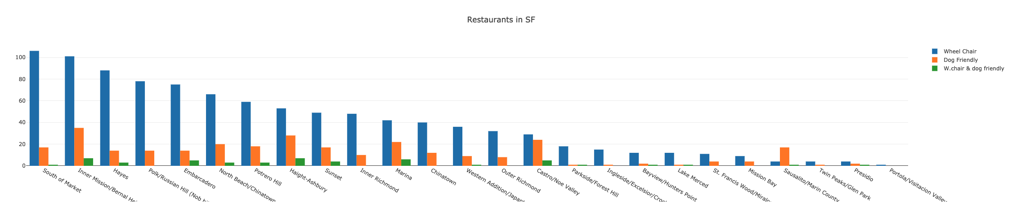
Data visualization - Plotly
Axis & Measurements
Neighborhoods frequency
//<UGH!>D3</UGH!>

Slide 7
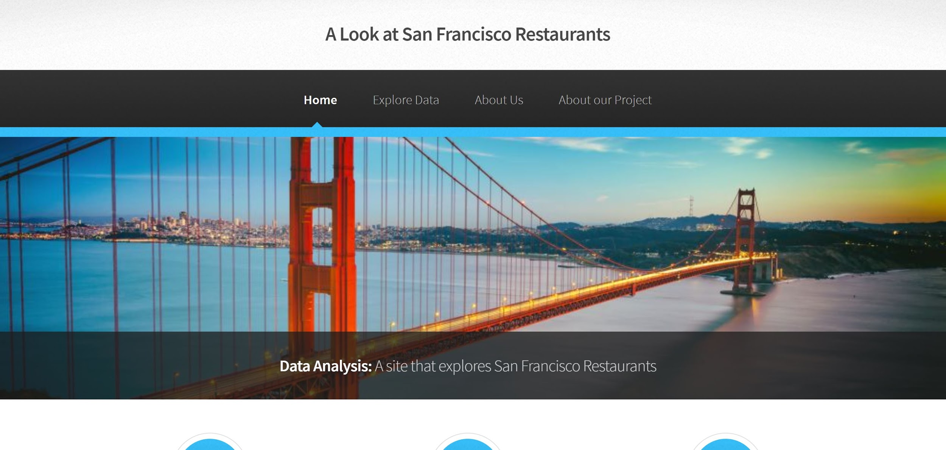
Our Webpage

Slide 8


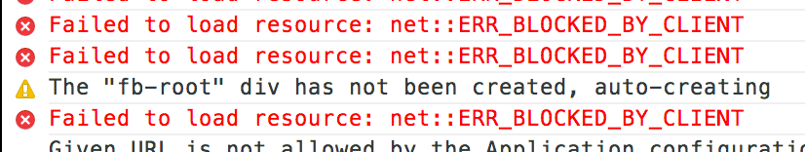
Issues
<Open source ≠ Perfect>
<Web Scraping Issues>
ACCESS DENIED!!
HELP!!!

Slide 9
Conclusions & Our Takeaways
Restaurant Accessibility is a huge issue for disabled people and those who, for whatever reason, need comfort dogs. This is much is clear, even in the most progressive city in the country.
Further Analysis - We noticed a trend of commerce in the flat parts of neighborhoods. We could be more accurate if we had topographical information to pair with lat and long data.

Slide 10
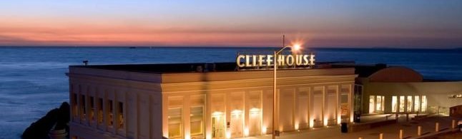
Questions?

